Slide 1
Twitch Streamer Dashboard
Lilit Akopyan, Natalie Cabayan, Ben Huang, Tim Hulak

Slide 2
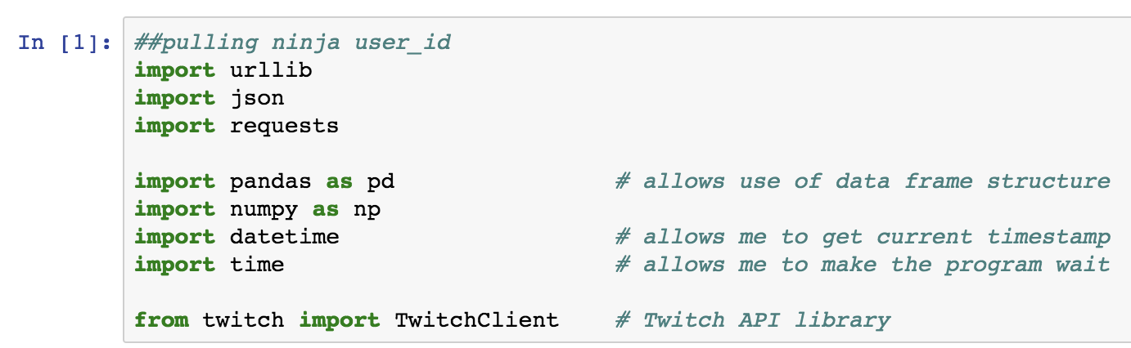
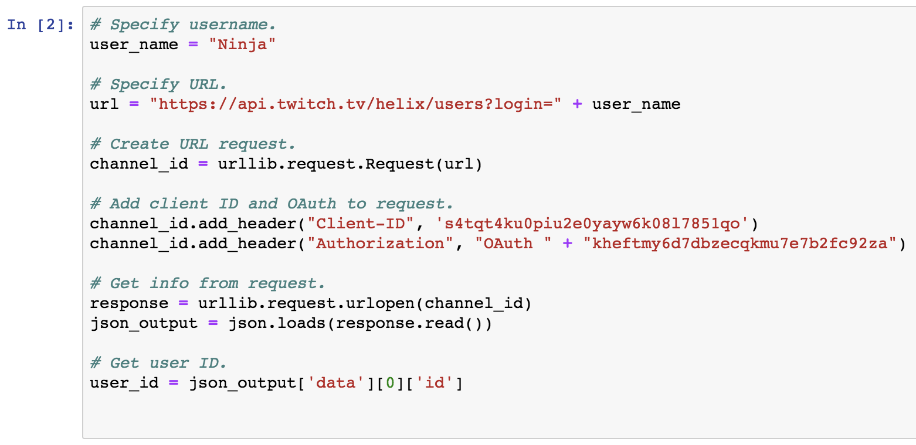
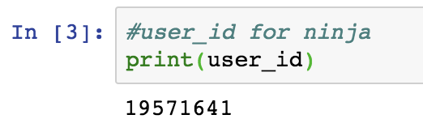
Identify Twitch User_ID

Slide 3
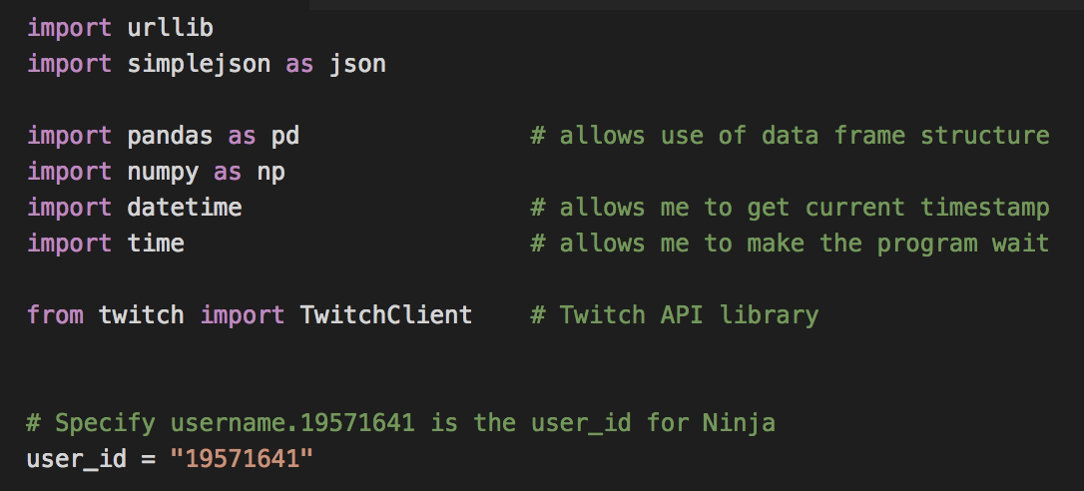
Twitch Follower API Script
Step 1: Import dependencies

Slide 4
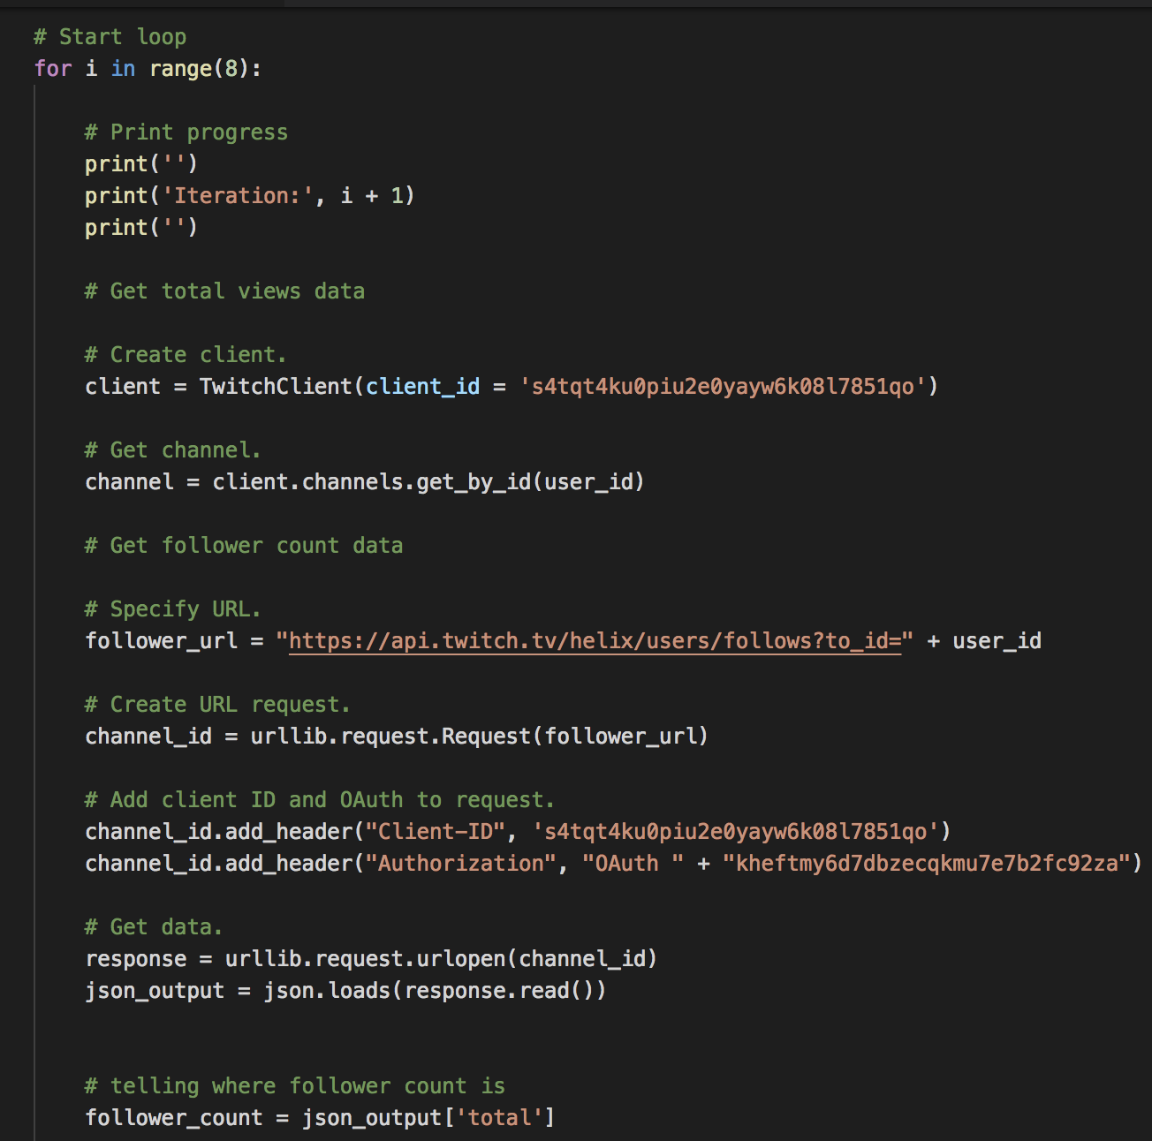
Twitch Follower API Script
Step 2: Create a For Loop
Change the user_id every time you run script for a different streamer

Slide 5
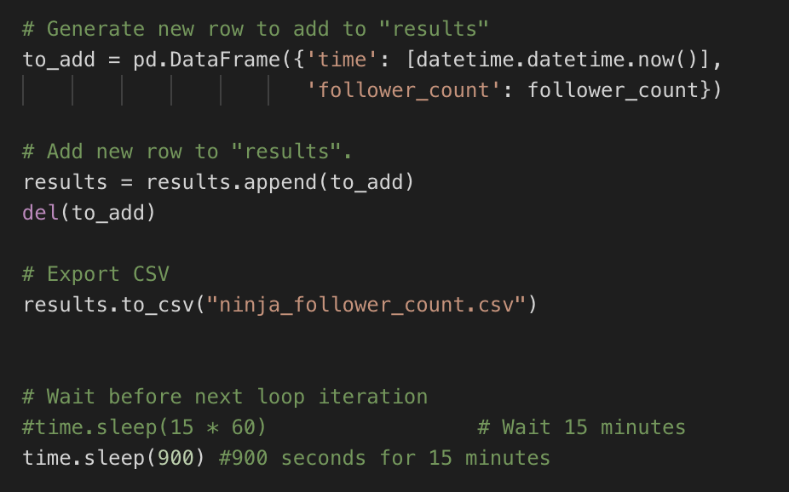
Twitch Follower API Script
Step 3: Export Results to CSV and Sleep Script
Have results export to a pre-named CSV for each streamer with columns for the time of the ping and the follower count.
Make sure to change the CSV file name to correspond with the streamer you are running it for.
Sleep the script for 900 seconds before it repeats itself

Slide 6
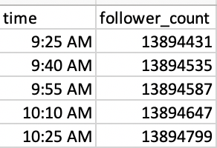
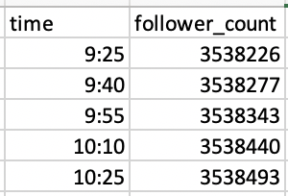
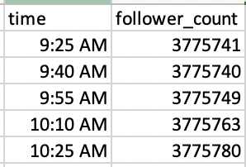
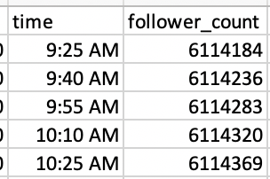
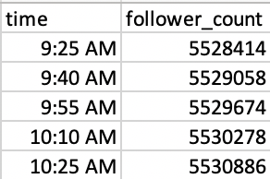
CSV Follower Output
Ninja
Riot Games
Summit1G
Shroud
Tfue

Slide 7
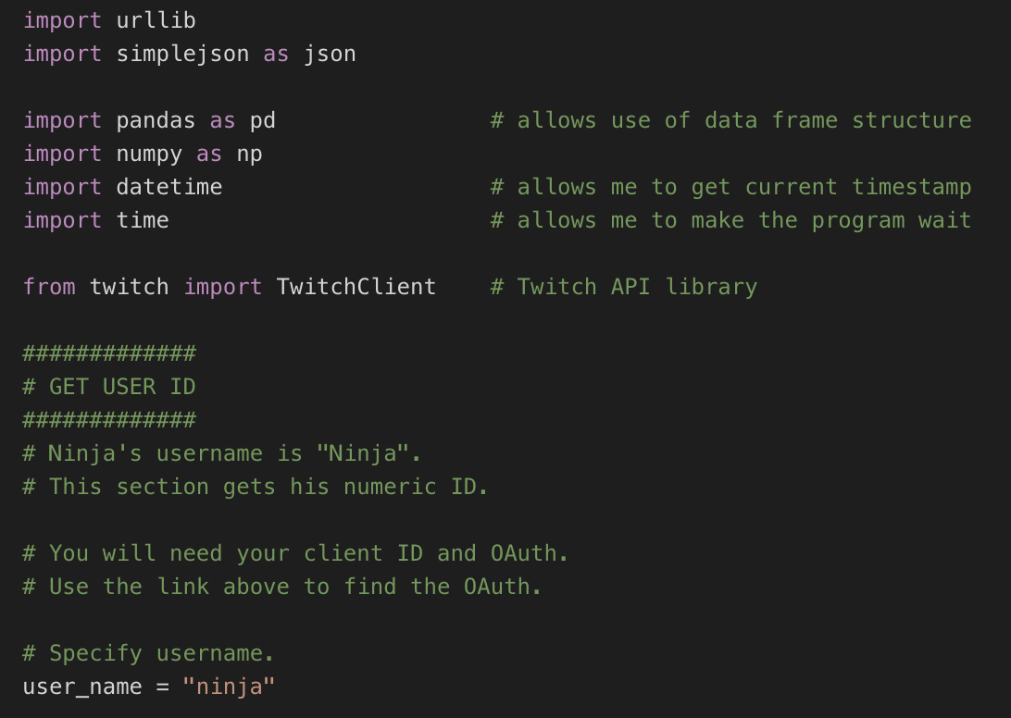
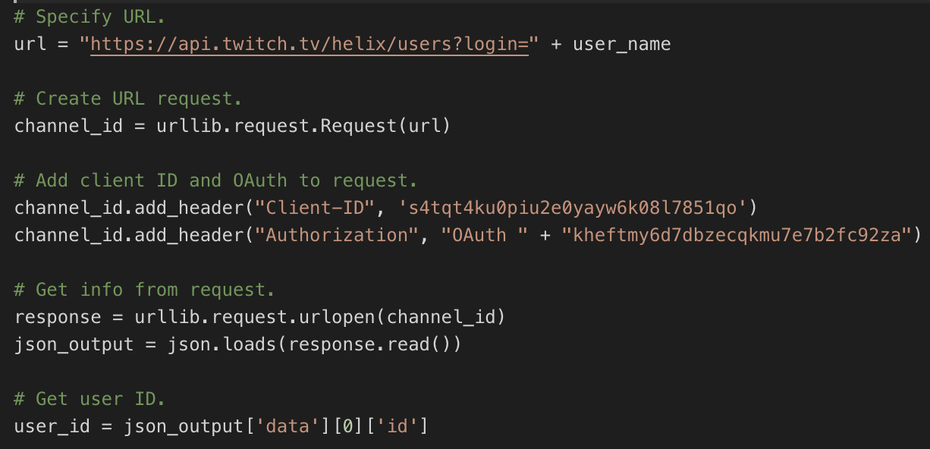
Twitch Stream API Script
Step 1: Import dependencies

Slide 8
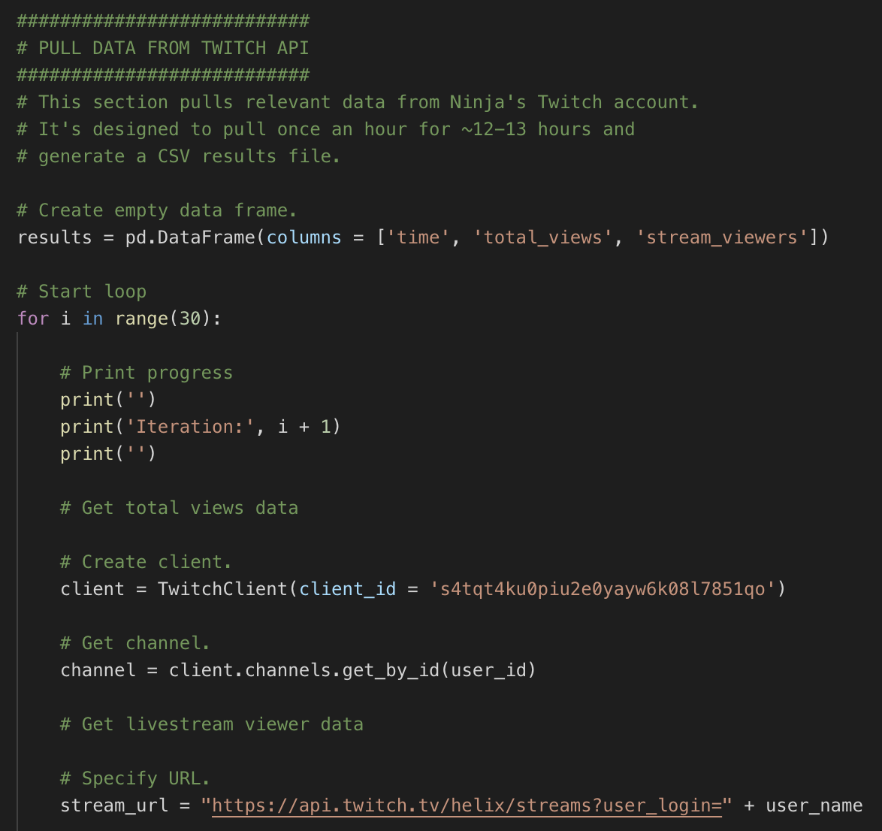
Twitch Stream API Script
Step 2: Create a For Loop
Change the user_id every time you run script for a different streamer

Slide 9
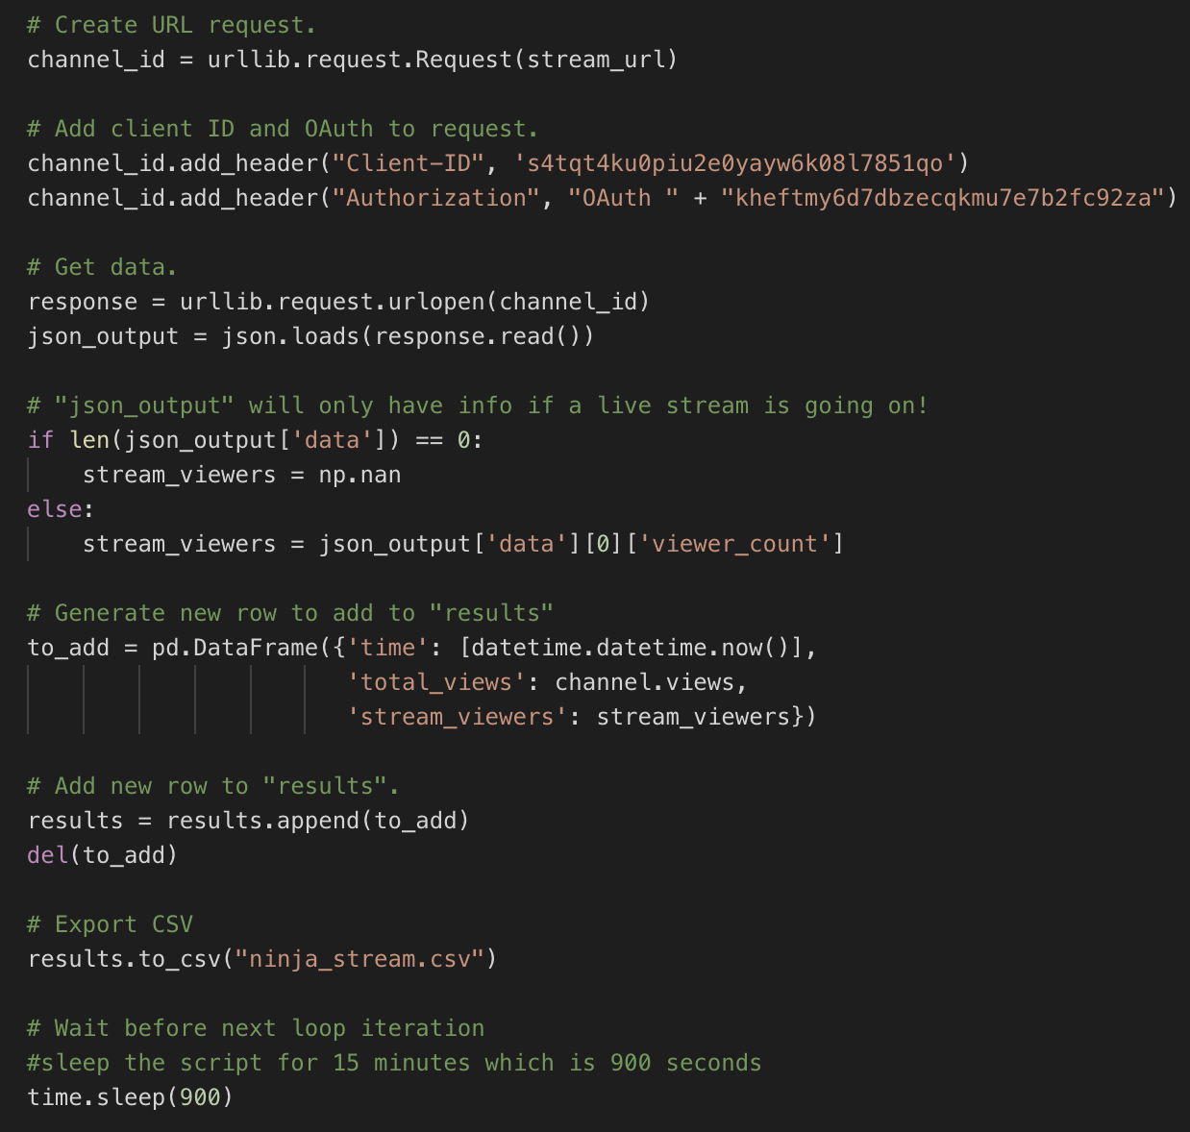
Twitch Stream API Script
Step 3: Export Results to CSV and Sleep Script

Slide 10
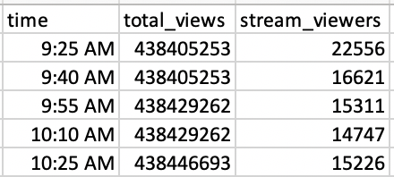
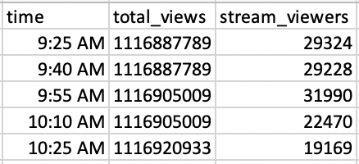
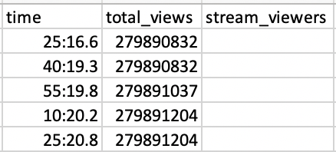
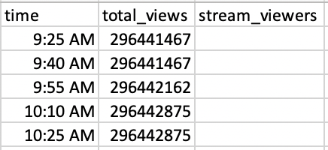
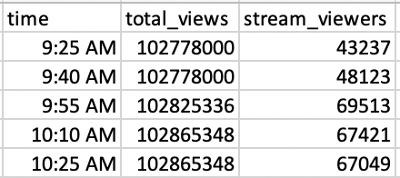
CSV Stream Output
Ninja
Riot Games
Summit1G
Shroud
Tfue

Slide 11
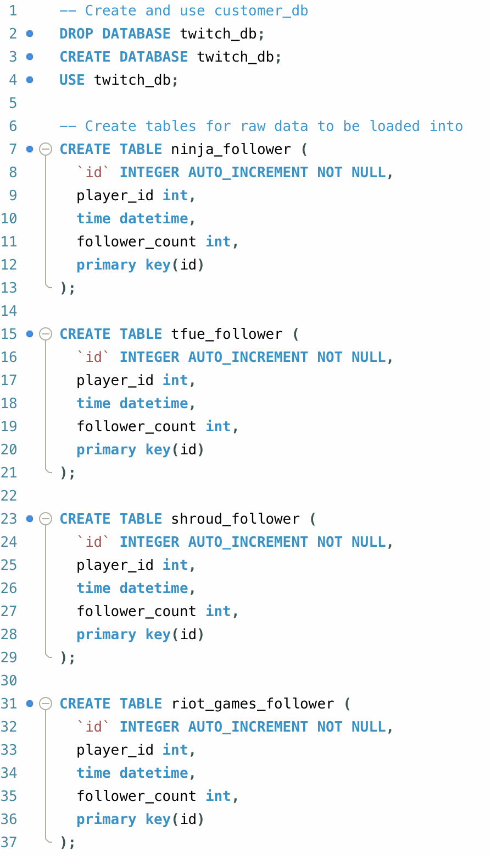
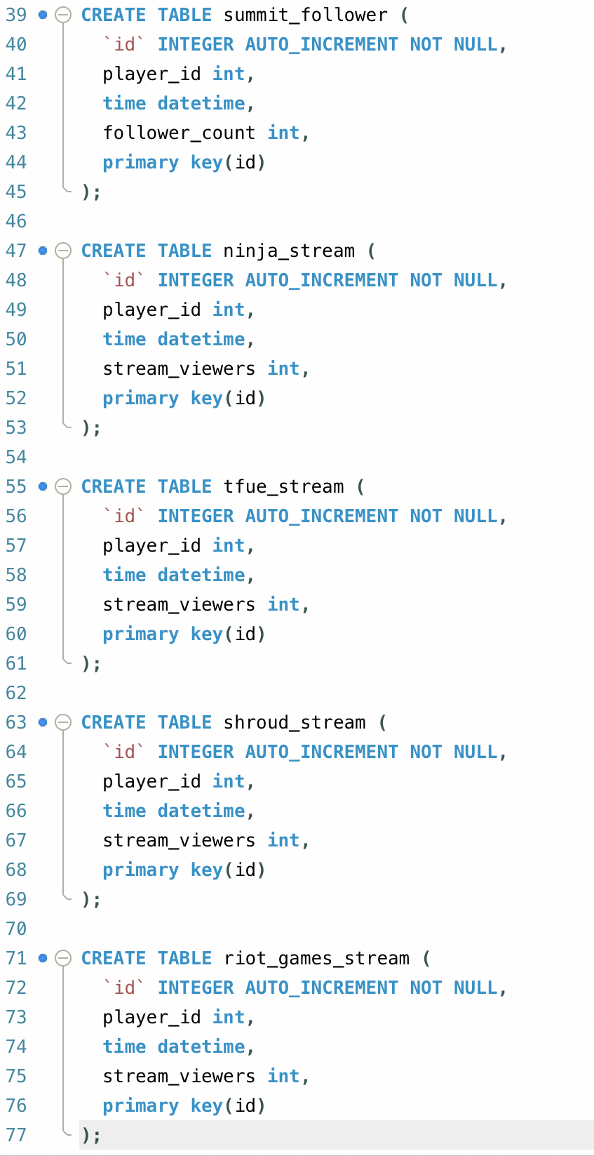
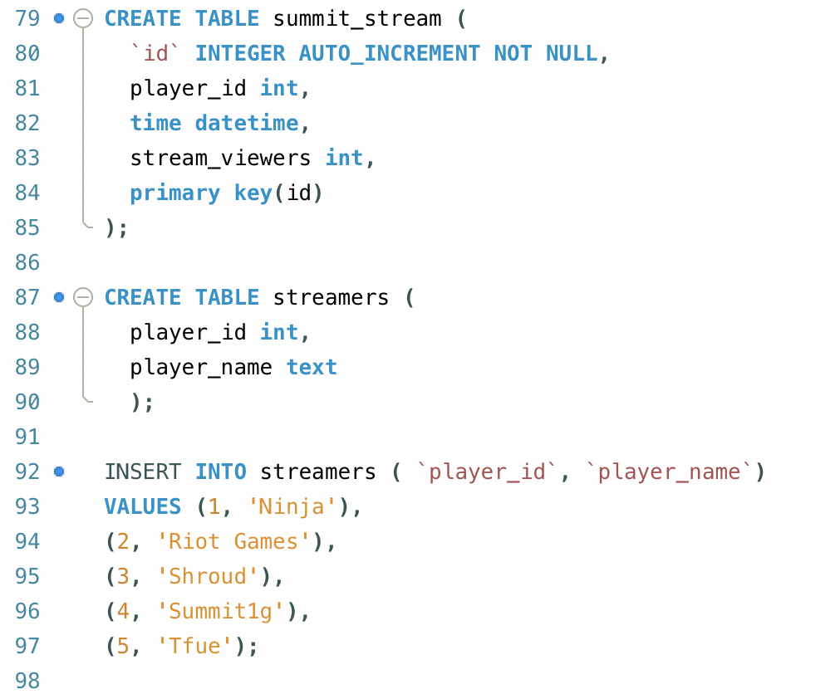
Creating SQL Database and Tables
Notes:
Each table is related in the way that they all ping the API at the same exact time, so the “time” column should equate within all tables; however, to make this clear to every user, we have added the “id” column to automatically increment, and be used as the primary key. Ideally, the ID column is what will be used to join the tables on each other.

Slide 12
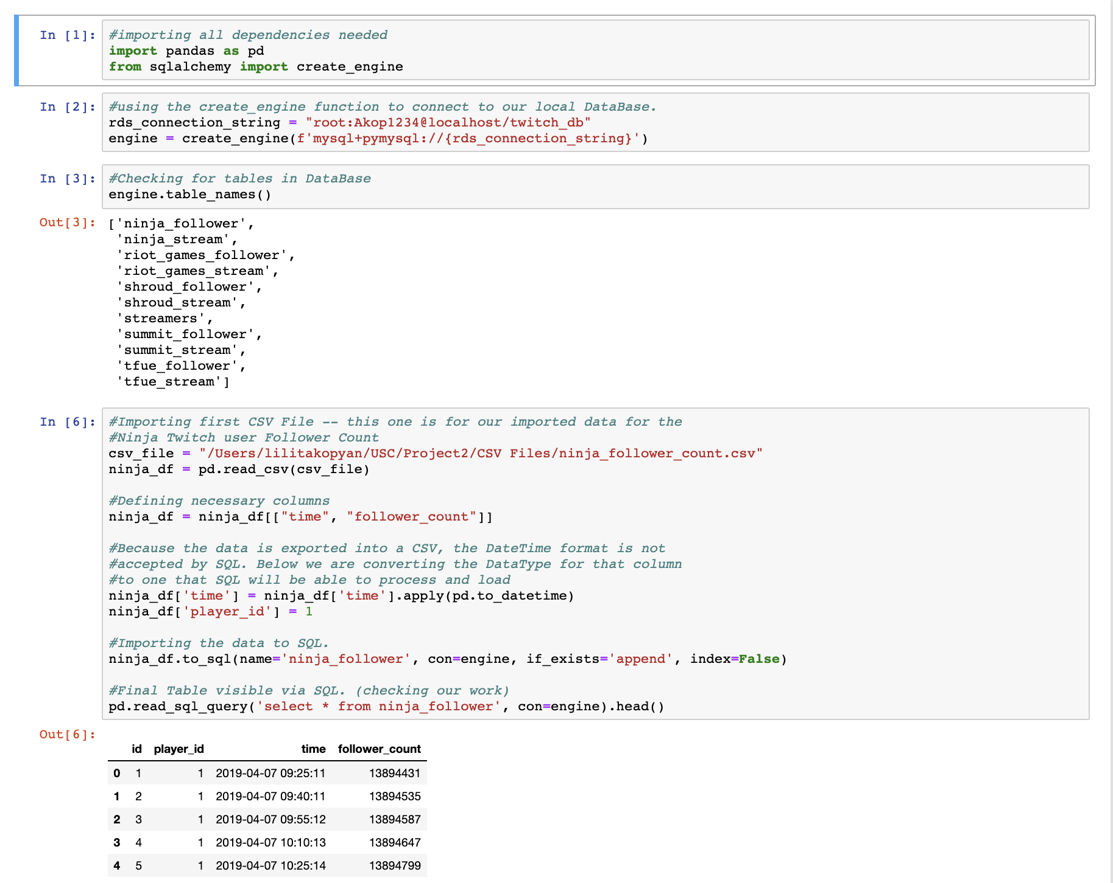
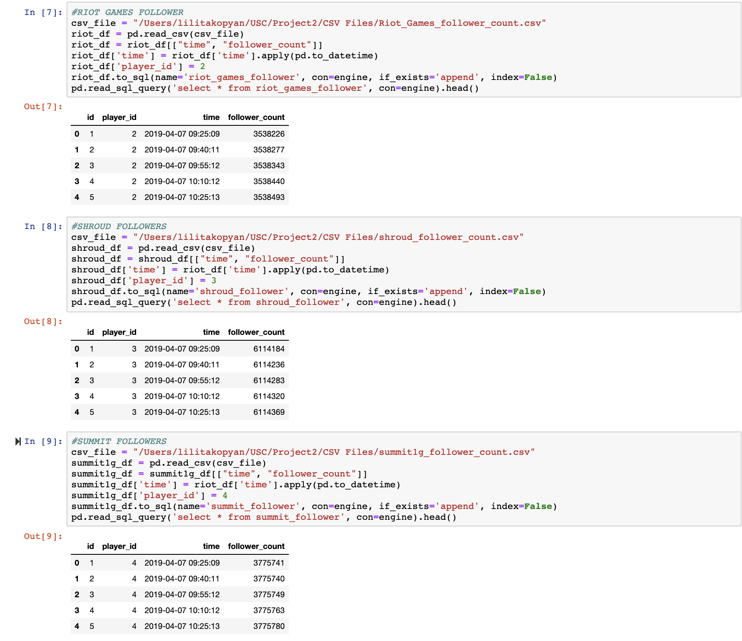
Using Pandas and SQLAlchemy to Load Data

Slide 13
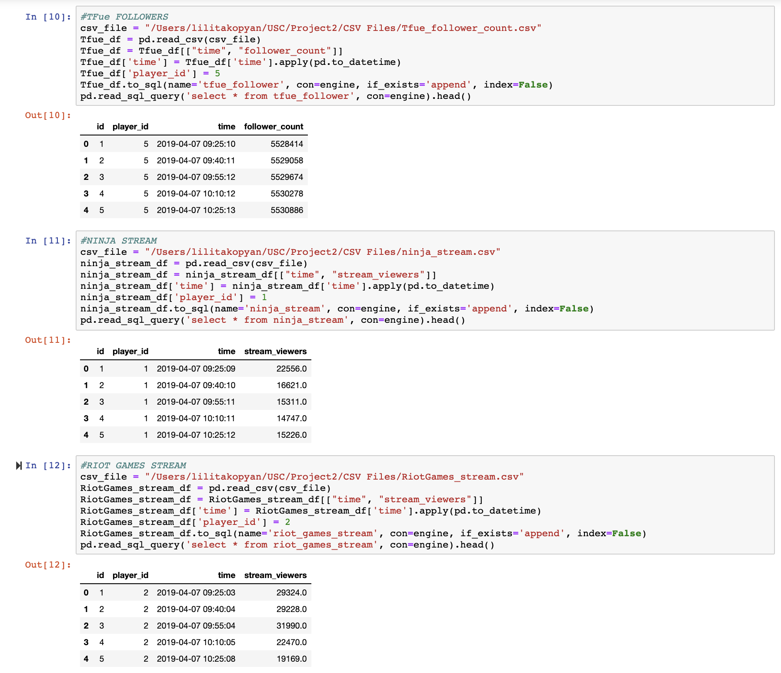
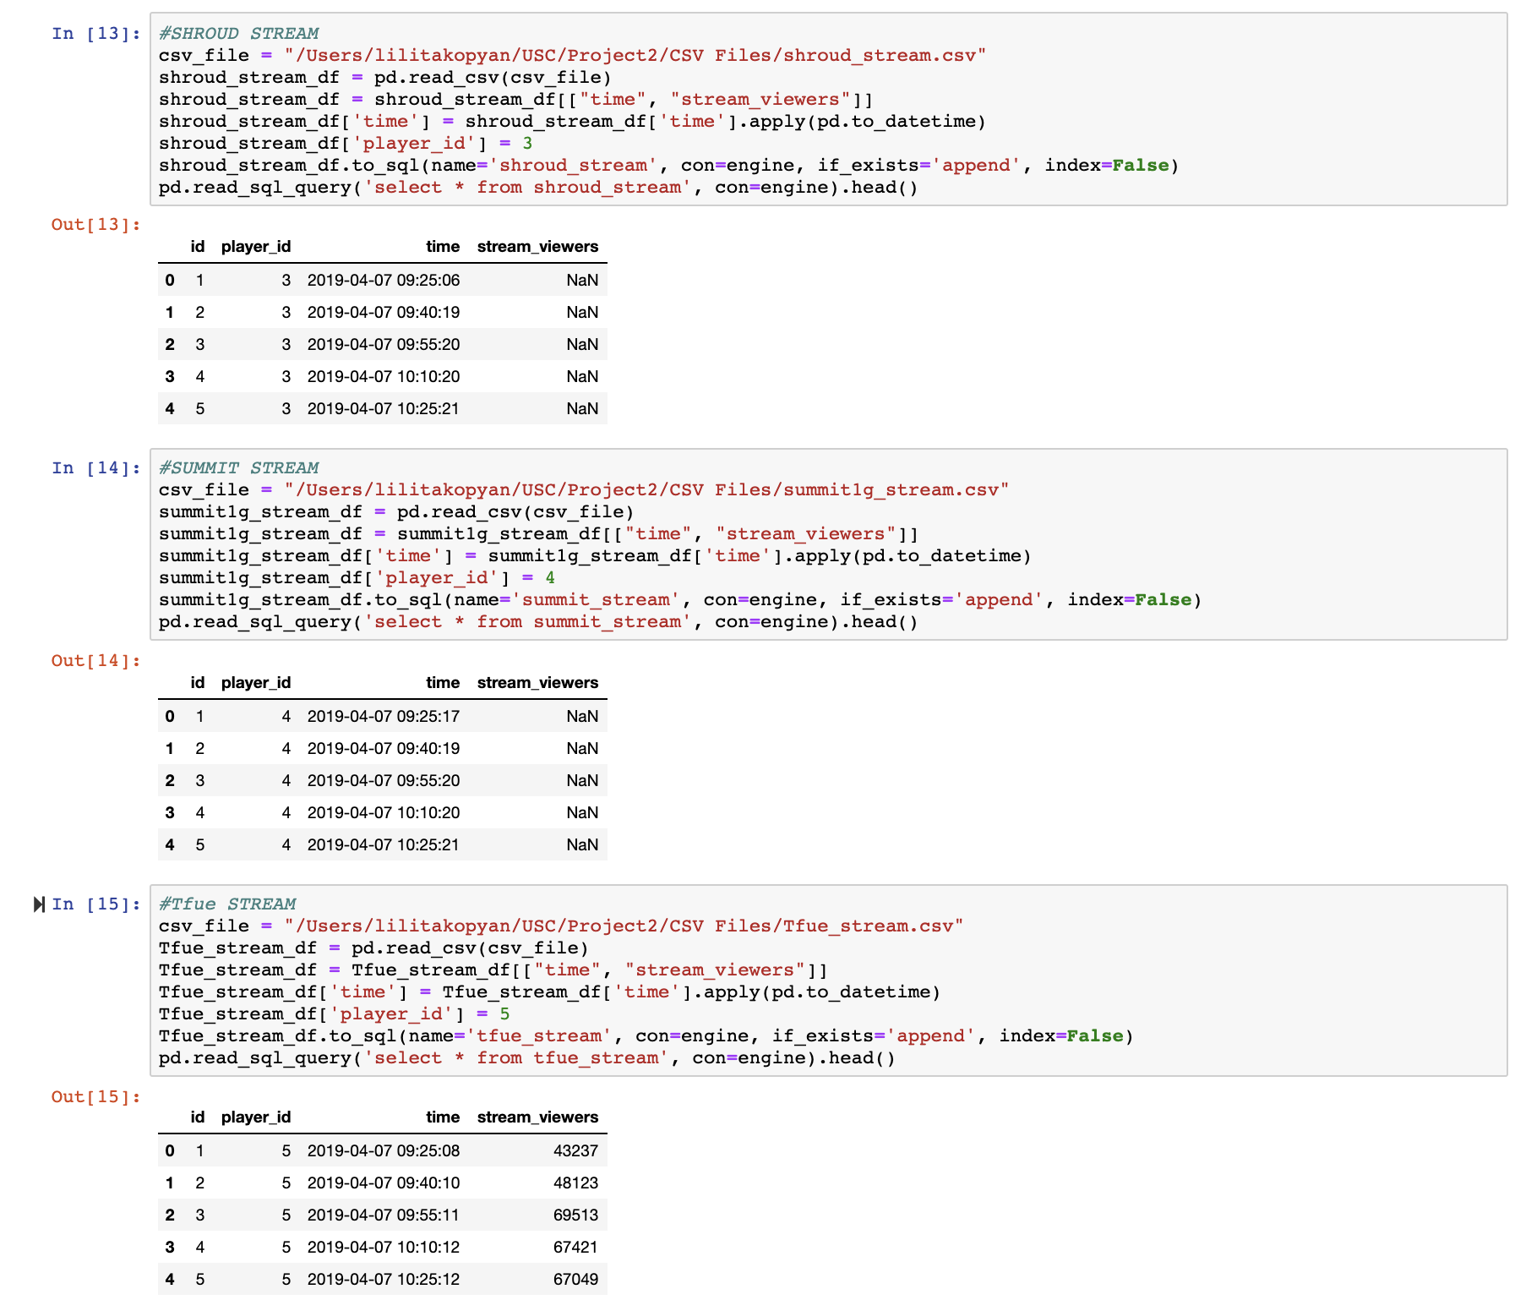
Loading Data Continued

Slide 14
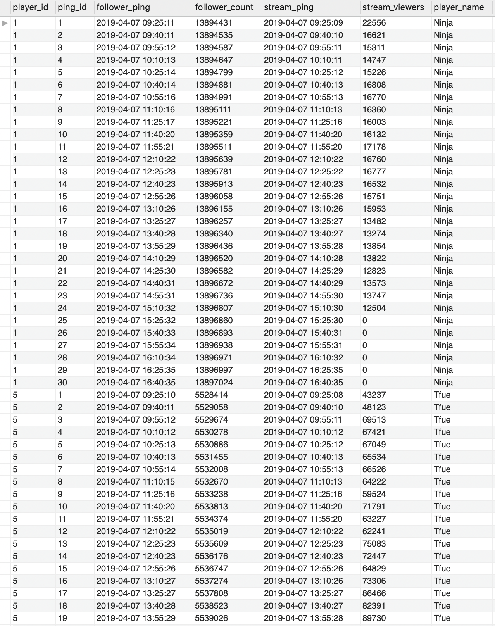
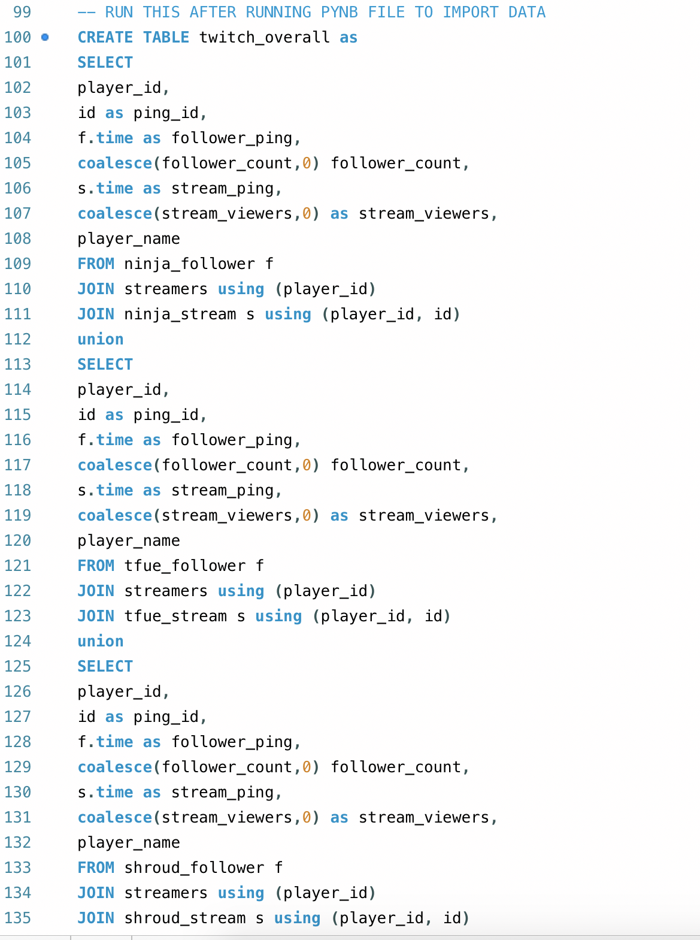
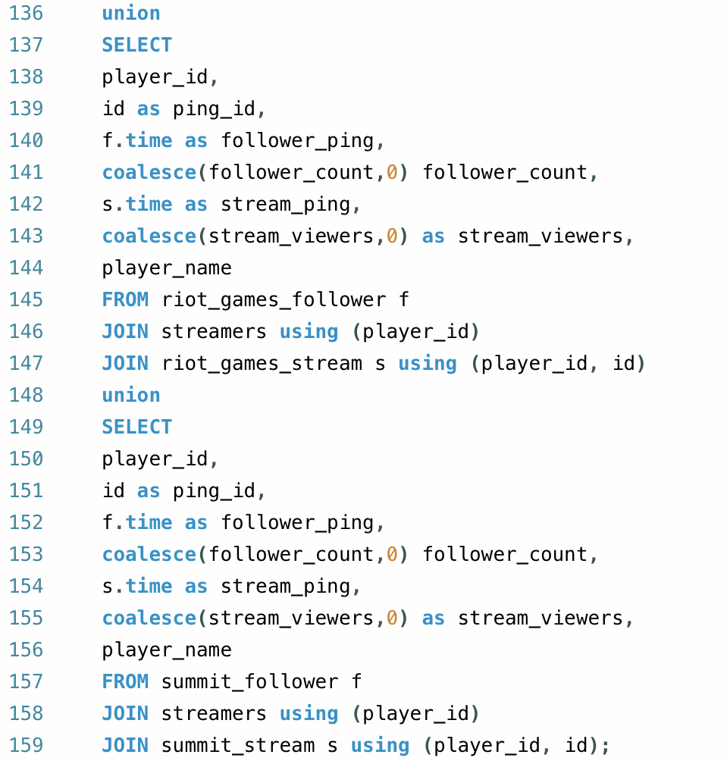
Joining DataTables - Master Table

Slide 15
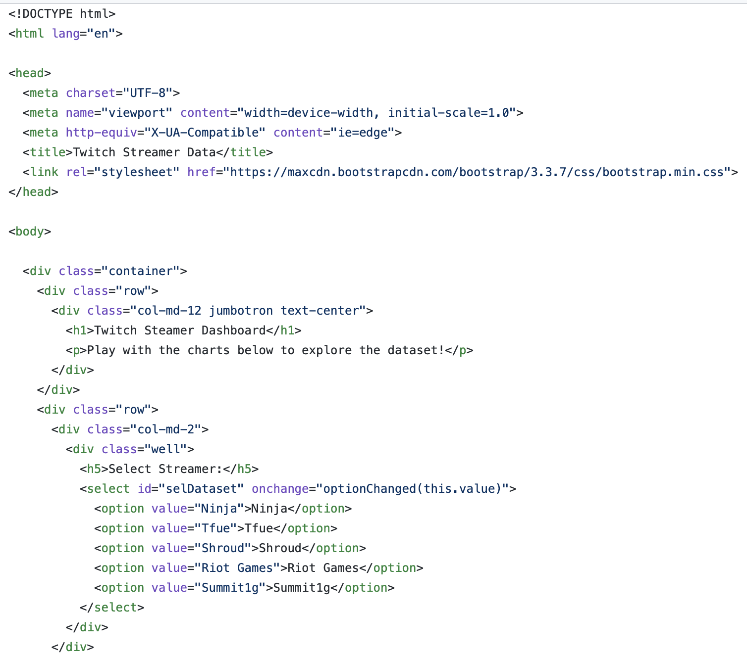
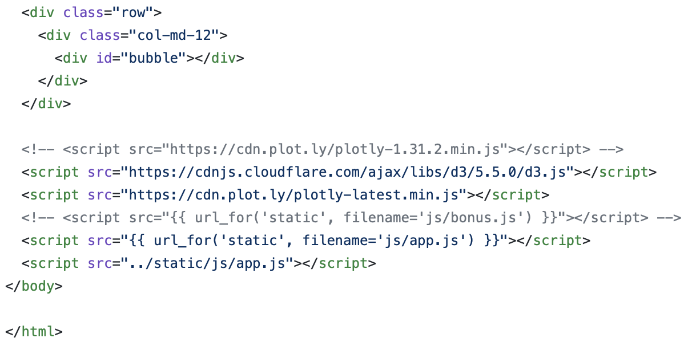
HTML

Slide 16
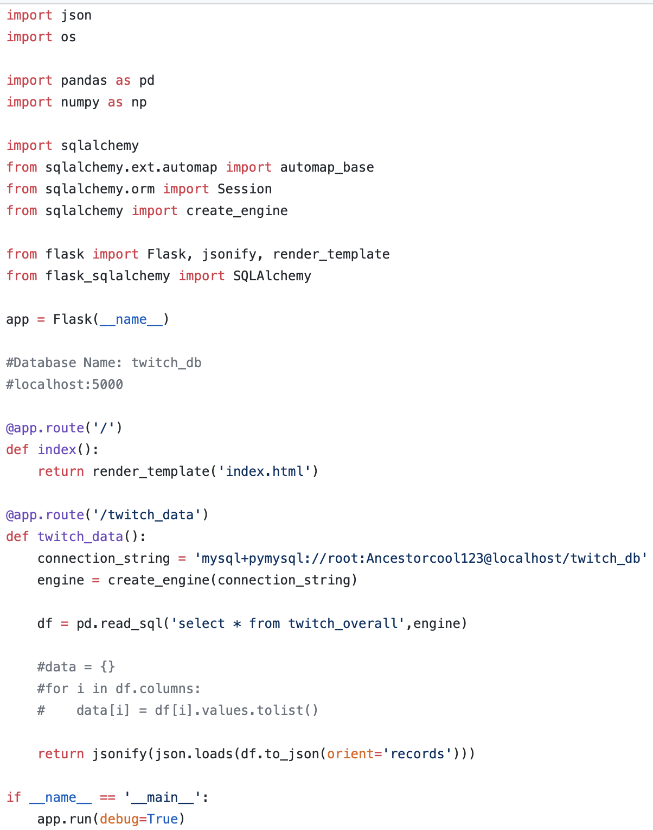
App.py

Slide 17
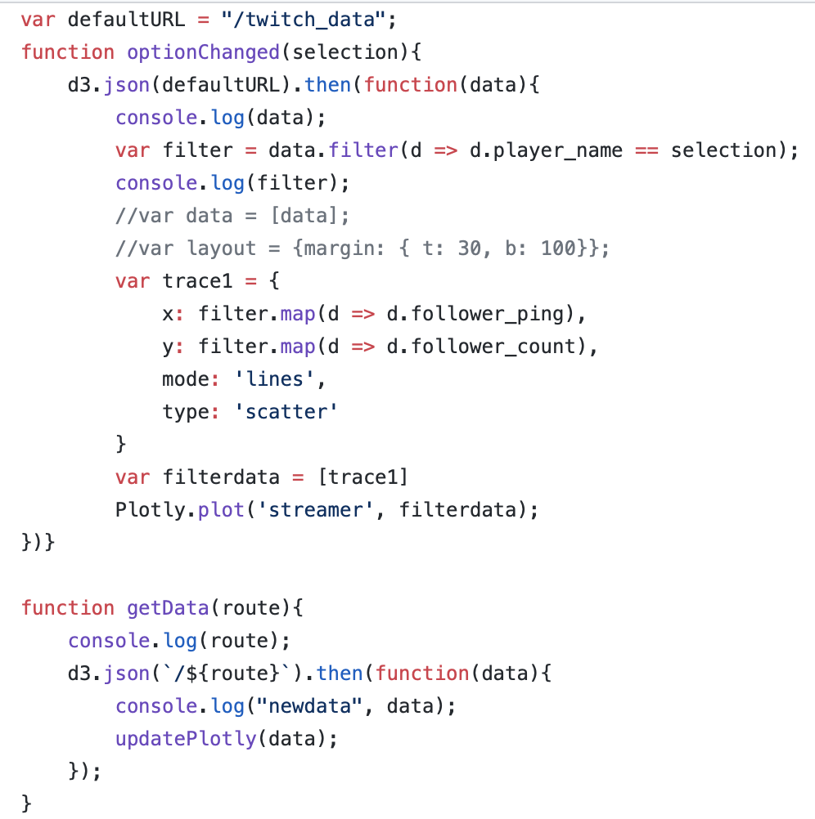
App.js

Slide 18
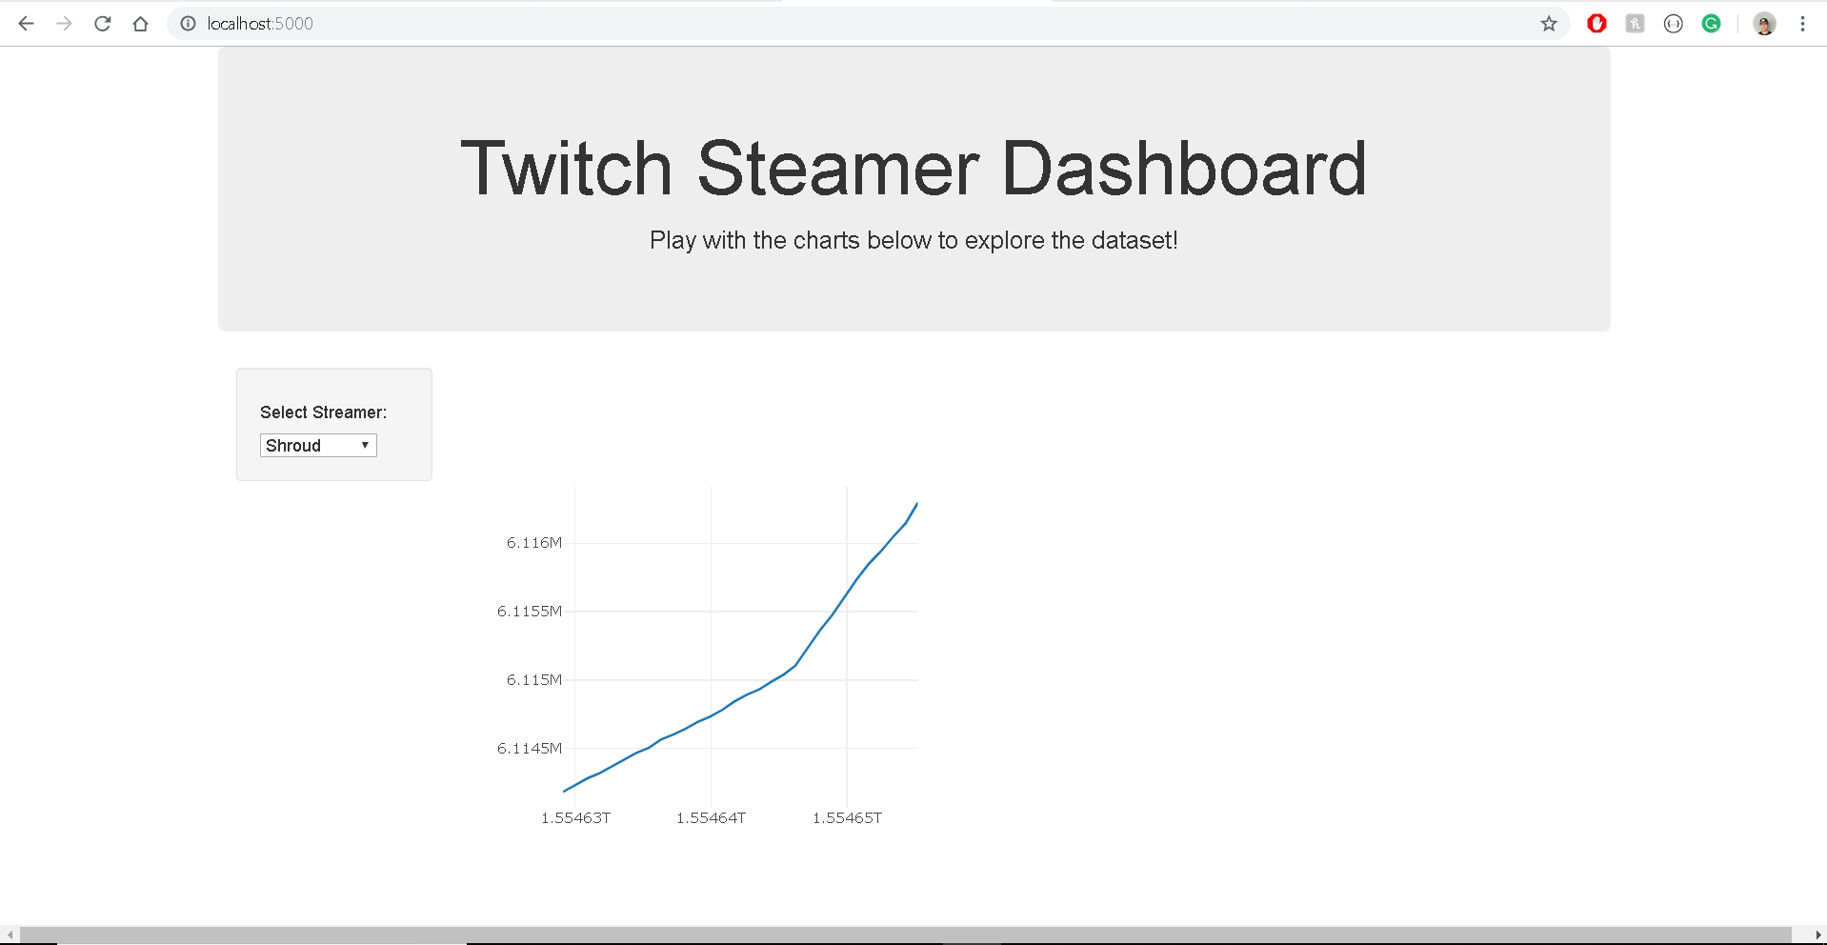
Dashboard - Shroud

Slide 19
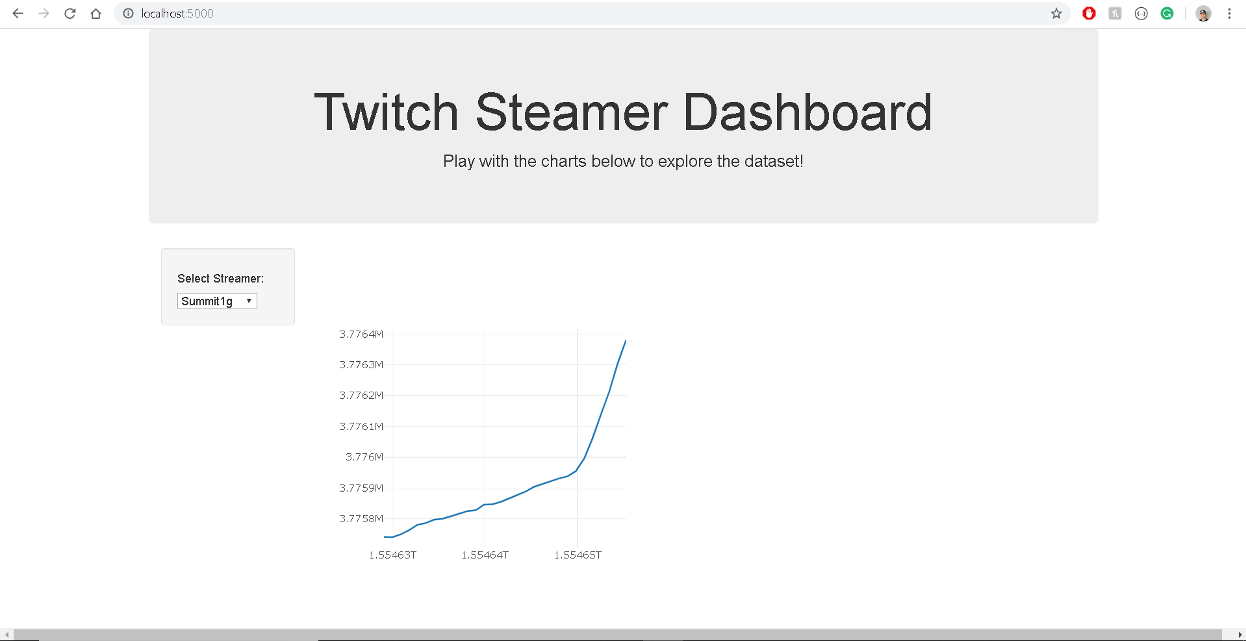
Dashboard - Summit1g

Slide 20
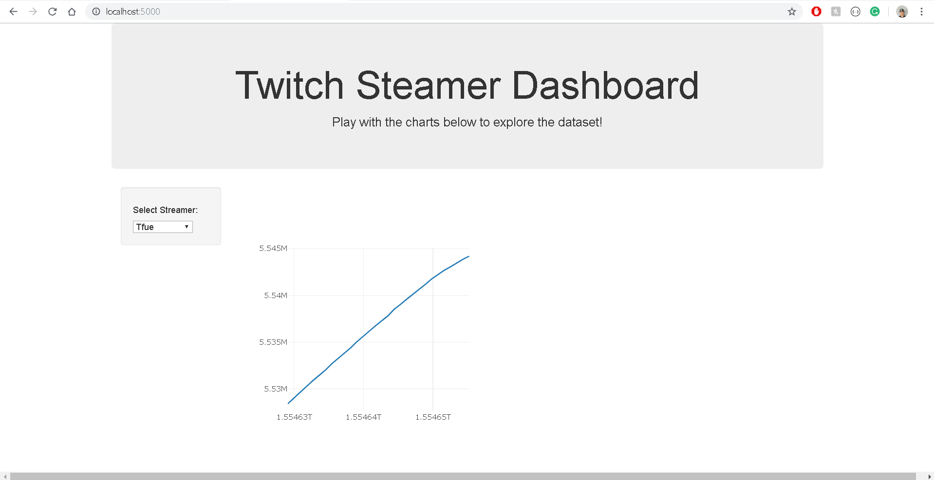
Dashboard - Tfue

Slide 21
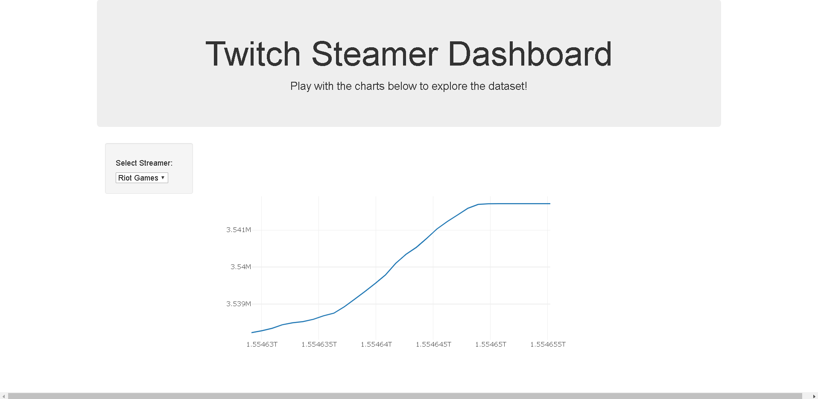
Dashboard - Riot Games

Slide 22
Potential Analysis
This could be used to compare growth for different streamers
It can also be used to compare gamers playing in similar gaming sectors
Can be used to monitor competition
Can be used to find potential gamers for companies to work with
Can help understand when to program content

